Slide 1

CS 5542 Final Showcase: Foundation Models for Image and Speech AI
Combined Showcase of Quiz Challenge I and Quiz Challenge II
Ibrahim Alborno

Slide 2

Quiz Challenge I — Controlled E-Commerce Image Generation
Goal: generate product images from structured product details
Problem: online stores need clean and consistent product visuals
Inputs: title, category, attributes, style, background
Sample products:
Men’s Running Shoes
Women’s Leather Handbag
Minimalist Ceramic Coffee Mug

Slide 3

Quiz Challenge I — Approach and Best Results
Compared 3 prompt styles:
naive prompt
structured prompt
structured prompt + negative prompt
Structured and controlled prompts gave cleaner results.
Best overall result: the mug example

Slide 4
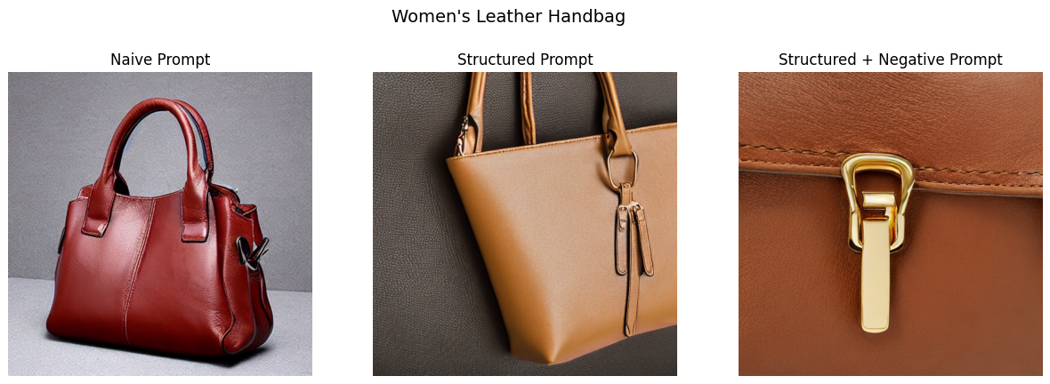

Slide 5
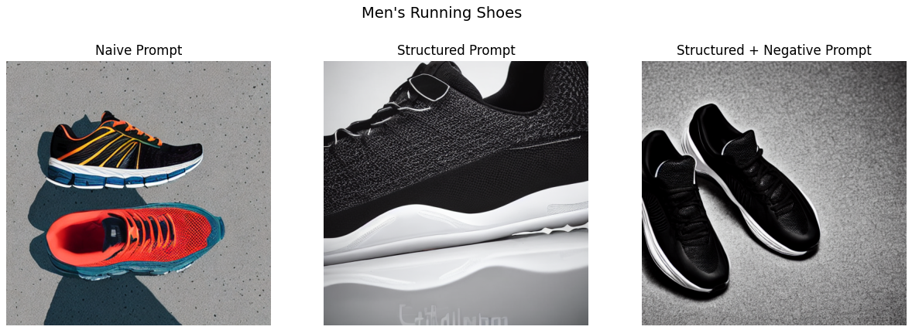

Slide 6
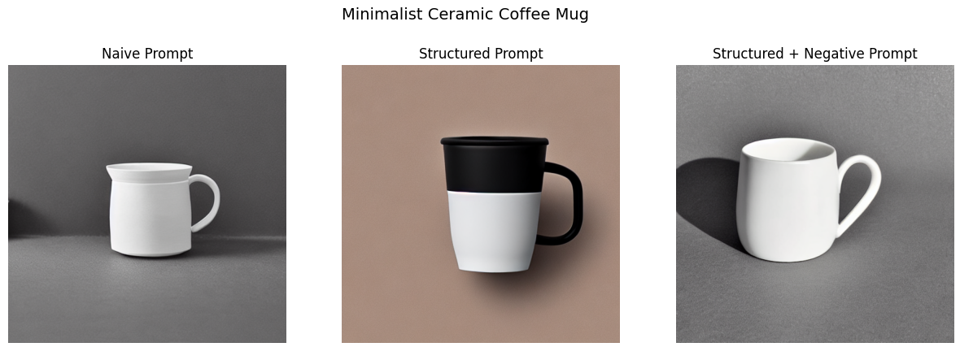

Slide 7
Quiz Challenge I — Key Findings
Findings
Better prompt design improved image quality
Structured prompts improved alignment
Negative prompts reduced clutter and distortion
Limitations
Some framing issues
Some zoomed-in outputs
Some inconsistency across prompt styles

Slide 8
Quiz Challenge II — AI Speech Intelligence with Whisper
Goal: turn spoken audio into useful structured output
Problem: audio takes time to review manually
Input: short self-recorded voice note
Use case: meeting or project update summarization

Slide 9
Quiz Challenge II — Approach and Best Results
Upload audio
Convert audio to WAV
Transcribe with Whisper Small
Generate summary, action items, and keywords
Compare baseline transcript vs improved output

Slide 10
Baseline Output Raw transcript only “Today we reviewed the progress of the project and discussed the next steps…”
Improved Output Summary: Today we reviewed the progress of the project and discussed the next steps. We finished the first part of the system and tested the initial model output. We still need to improve the evaluation section, update the slides and upload the final files to GitHub.
Action Items:
Improve the evaluation section
Update the slides
Upload the final files to GitHub
Complete the demo video
Review the results and prepare for the final submission
Keywords: final, progress, project, next steps

Slide 11
Quiz Challenge II — Key Findings
Findings
Whisper worked well for short clear speech
Transcription quality was strong
Structured output improved usefulness
Limitations
Worked best with short clear audio
Action item extraction was rule-based
CPU runtime was slower than GPU

Slide 12
Technical Growth and Project Evidence
Technical Growth
Learned prompt engineering for image generation
Learned Whisper-based speech transcription
Built two working AI pipelines in Google Colab
Practiced evaluation, analysis, and project packaging
Quiz Challenge 1 GitHub: https://github.com/Ibrahim17A/Quiz-Challenge-1
Quiz Challenge 2 GitHub: https://github.com/Ibrahim17A/Quiz-Challenge-2
Quiz Challenge 1 Video: https://youtu.be/ELXB5Kzanhc
Quiz Challenge 2 Video: https://youtu.be/ze_XmmZESyo

Slide 13
Conclusion and Future Work
Quiz Challenge 1 showed that prompt design improves image generation quality and control
Quiz Challenge 2 showed that speech models can create useful structured outputs from audio
Both projects showed the importance of input design, evaluation, and limitations
Future work:
stronger control methods for image generation
better summarization and action item extraction for speech
larger and more realistic datasets

Slide 14

THANK YOU
Ibrahim Alborno
https://github.com/Ibrahim17A/Final-Challenge-Presentation

